Slide 2

About Nestlé
The largest food and beverage company worldwide
Market Capitalization: 304.1 billion U.S. dollars
(The 100 largest companies in the world by market capitalization in 2020, 2020)
No.13 in the ranking of the largest companies in 2020
More than 2000 brands across 187 countries
(Nestlé, no date)
Image from https://nsafd.co.uk/industry-case-studies/nestle-uk-ireland

Slide 3
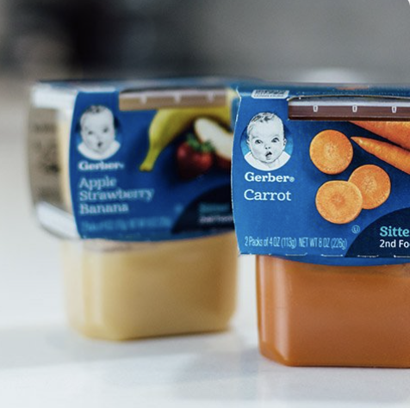
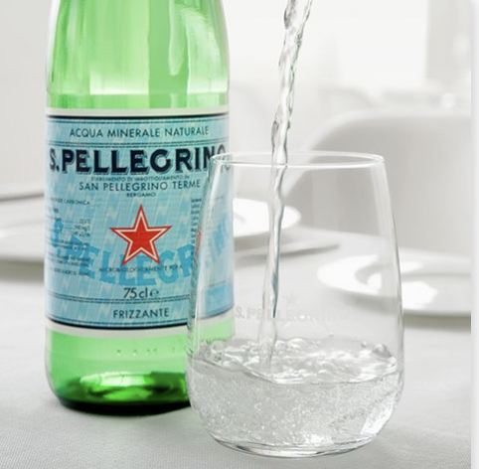
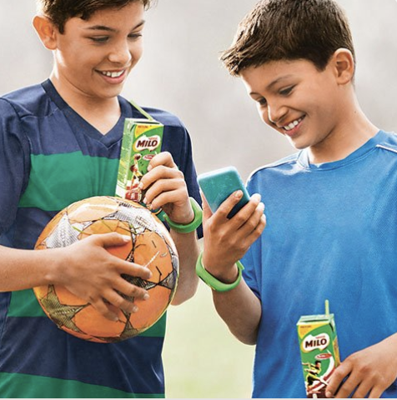
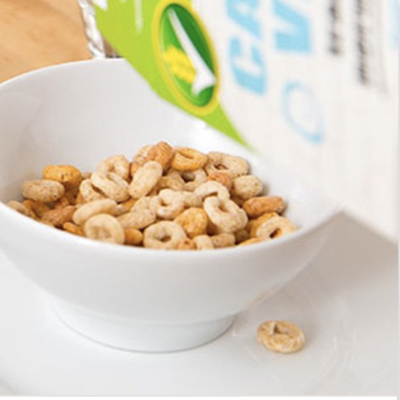
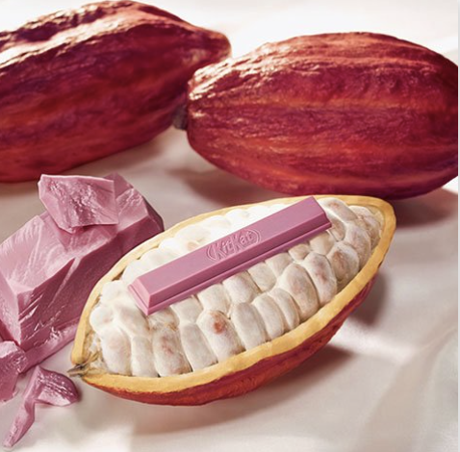
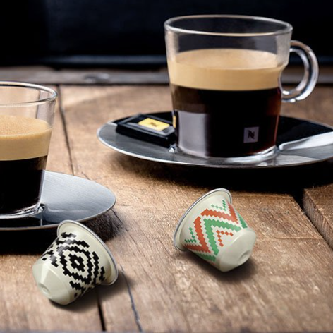
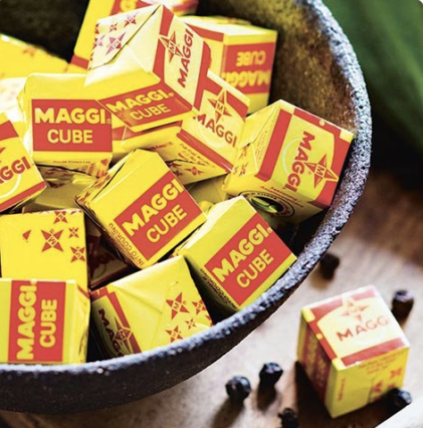
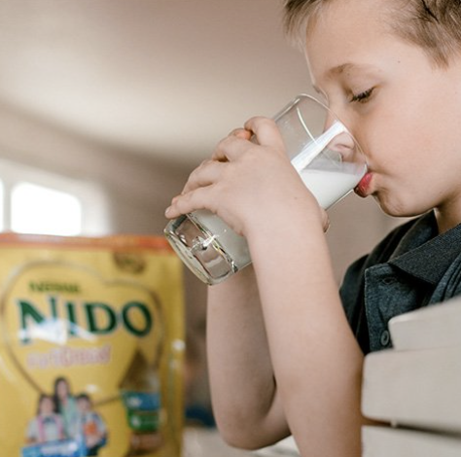
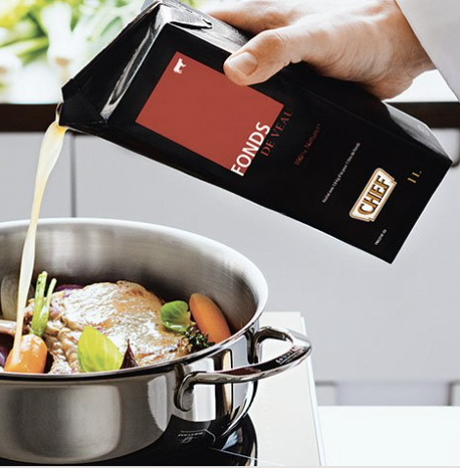
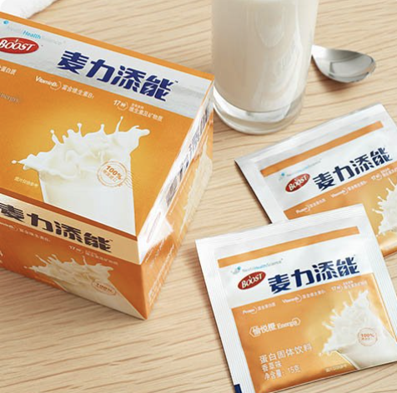
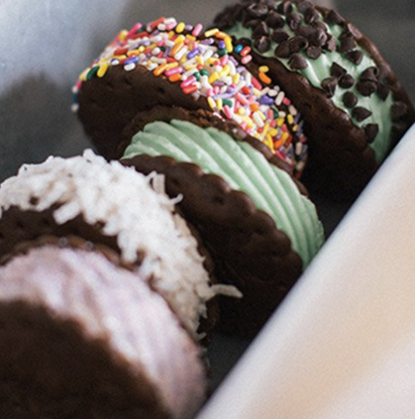
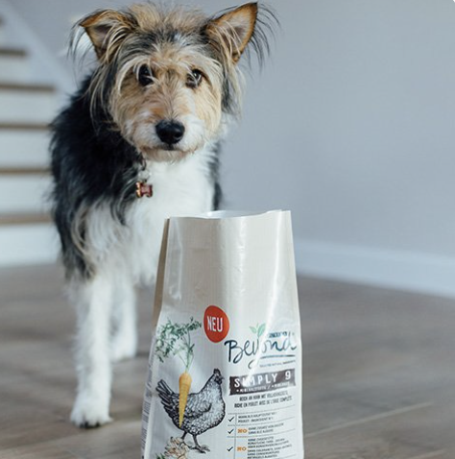
Products & brands Products
Baby Food
Bottled Water
Drinks
Cereals
Chocolate & Confectionery
Coffee
Culinary, chilled & frozen food
Dairy
Food Service
Healthcare Nutrition
Ice Cream
Petcare
Images from https://www.nestle.com/brands

Slide 4
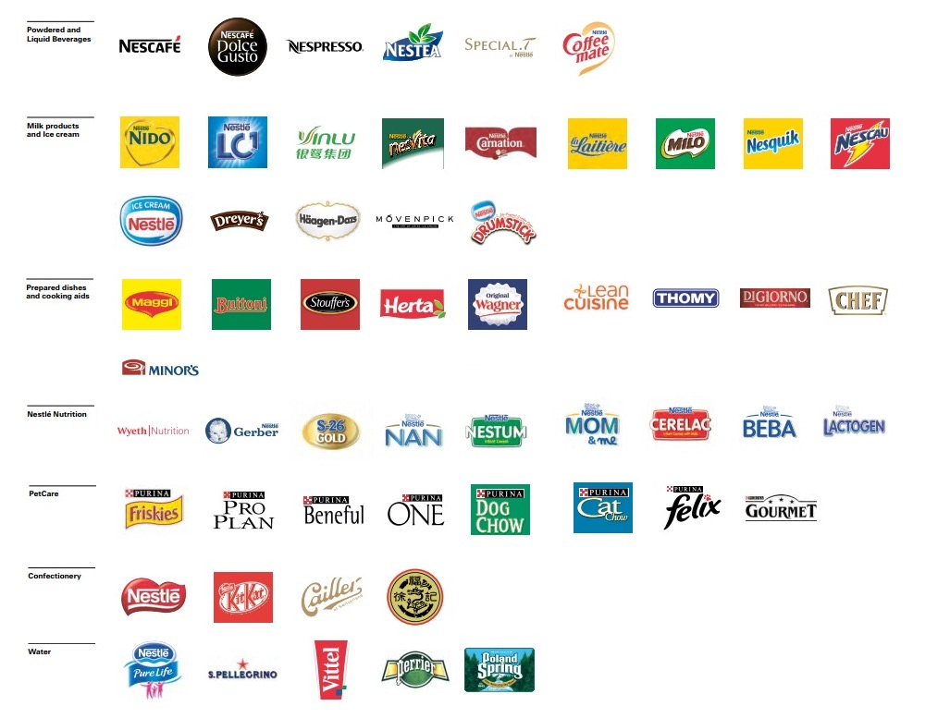
Products & brands Brands
Source: Nestlé website

Slide 5
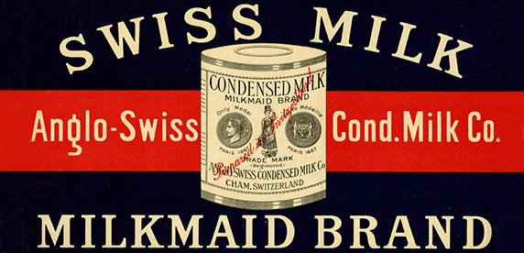
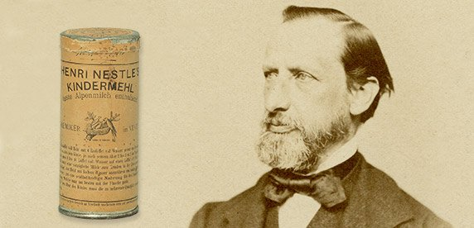
History of Nestlé Establishment (Switzerland in 1905)
Anglo-Swiss
Nestlé
1866
US brothers Charles and George
Condensed Milk
1867
Germany Henri Nestlé
Infant Food
(Nestlé, 2016)

Slide 6
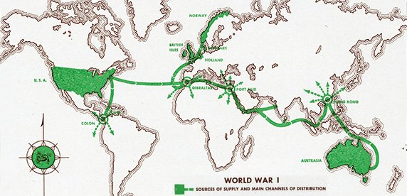
History of Nestlé Internationalization
1960
1962
1987
France
Sweden
China
1882
1905
1916
1918
1938
1939
The USA
The UK
Germany
Norway
Australia
Brazil
Asia
Africa
Latin America

Slide 7
History of Nestlé Internationalization
1882
1905
1916
1918
1938
1939
1960
1962
1987
The USA
The UK
Germany
Norway
Australia
Brazil
Asia
Africa
Latin America
France
Sweden
China

Slide 8
Referencing list
The 100 largest companies in the world by market capitalization in 2020 (2020) Available at: https://www.statista.com/statistics/263264/top-companies-in-the-world-by-market-capitalization/
Nestlé(no date) About us. Available at: https://www.nestle.com/aboutus
Nestlé(2016) Nestlé timeline 1866-today. Available at: https://www.nestle.co.uk/en-gb/media/newsfeatures/nestle-150-years-timeline

